Slide 1
Transformers & Large Language Models (LLMs)
From Concepts to Practice - ML Course Day 4
Presented by
Mahamad Salah
Anton Popov
ML for Biomedical Research @ BSC
May 22nd, 2025
1

Slide 2
Content
1
A Trip Down Memory Lane
2
Word Embeddings
3
An Intro to LLMs
4
Attention is All You Need
5
The Anatomy of a Transformer
6
Beyond Text
ML for Biomedical Research @ BSC
May 22nd, 2025
2

Slide 3
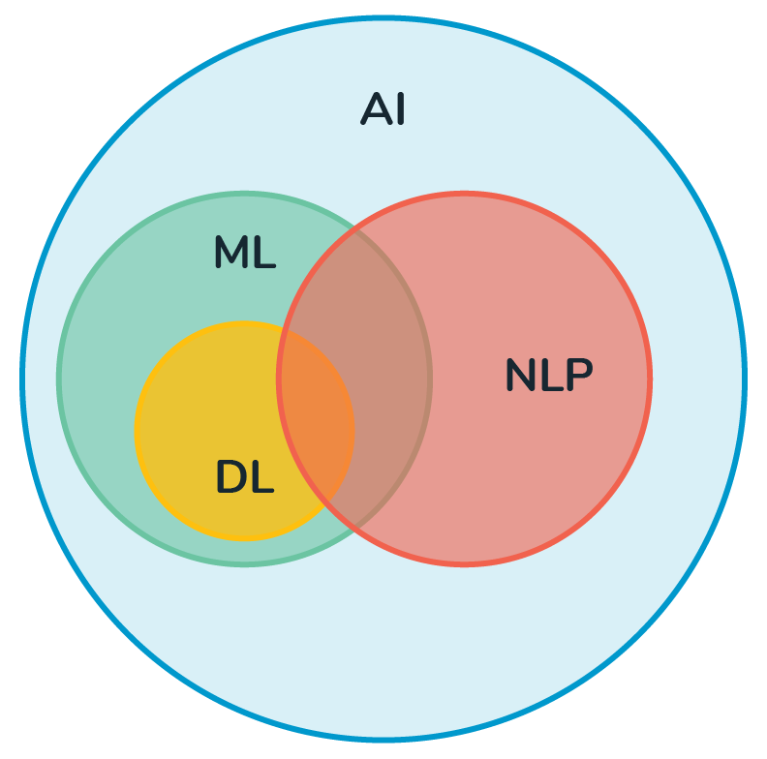
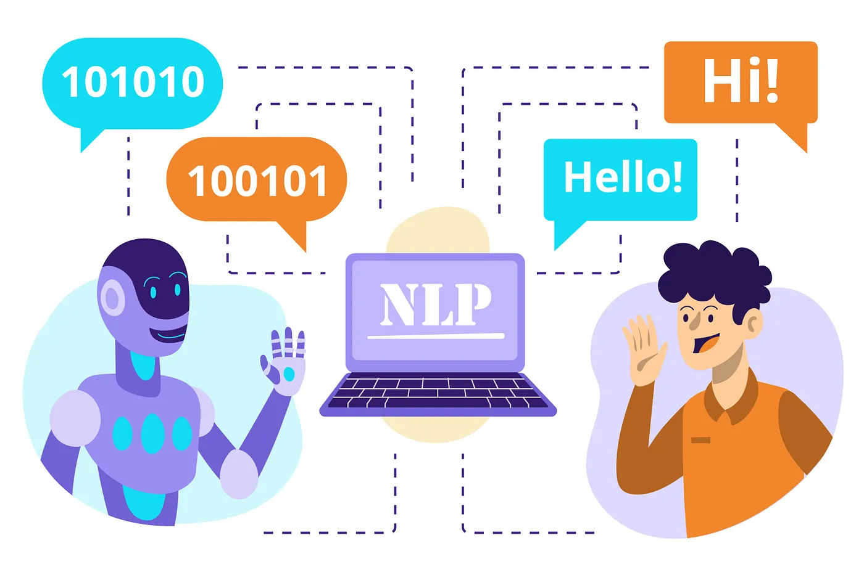
Natural Language Processing
ML for Biomedical Research @ BSC
May 22nd, 2025
3

Slide 4


The Rule-Based Era
ML for Biomedical Research @ BSC
May 22nd, 2025
4

Slide 5

N-Grams
ML for Biomedical Research @ BSC
May 22nd, 2025
5

Slide 6
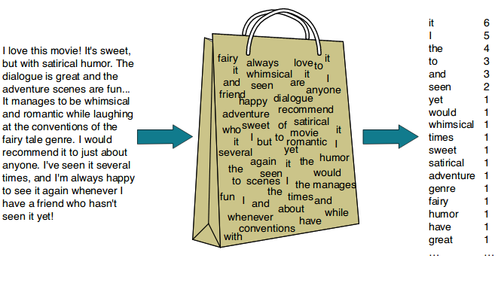
Bag of Words
ML for Biomedical Research @ BSC
May 22nd, 2025
6

Slide 7
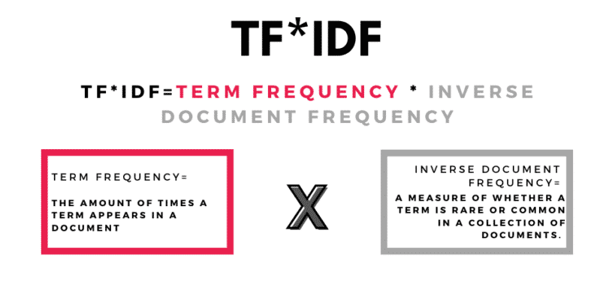
TF-IDF
ML for Biomedical Research @ BSC
May 22nd, 2025
7

Slide 8
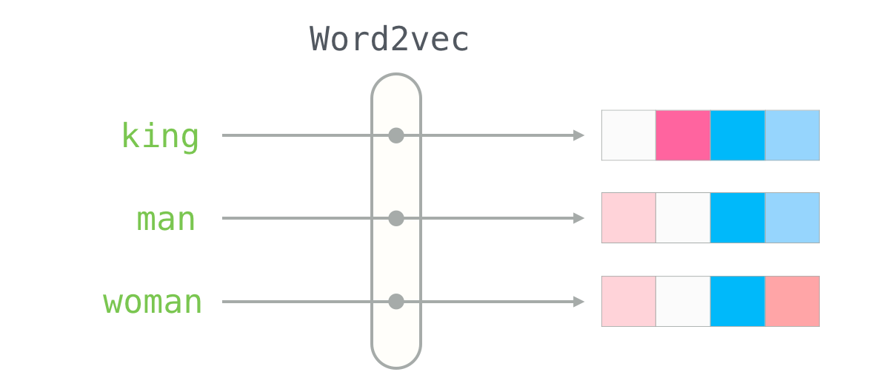
Word Embeddings
ML for Biomedical Research @ BSC
May 22nd, 2025
8

Slide 9
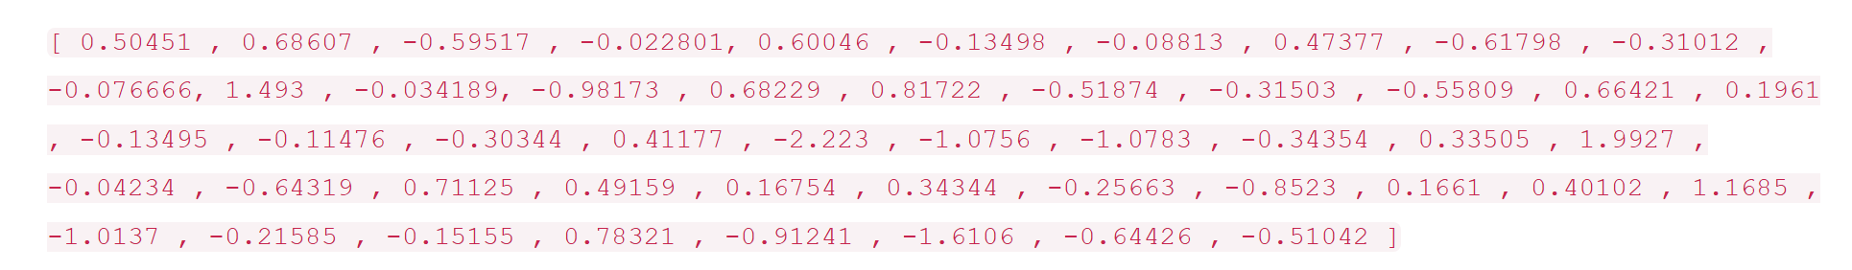
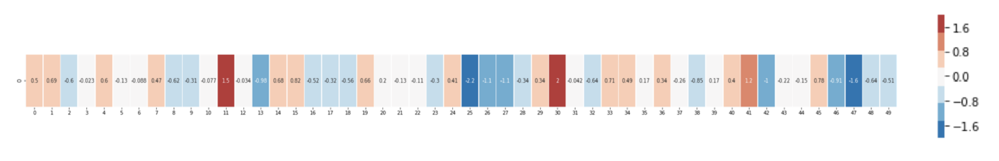
Word Embeddings
ML for Biomedical Research @ BSC
May 22nd, 2025
9

Slide 10
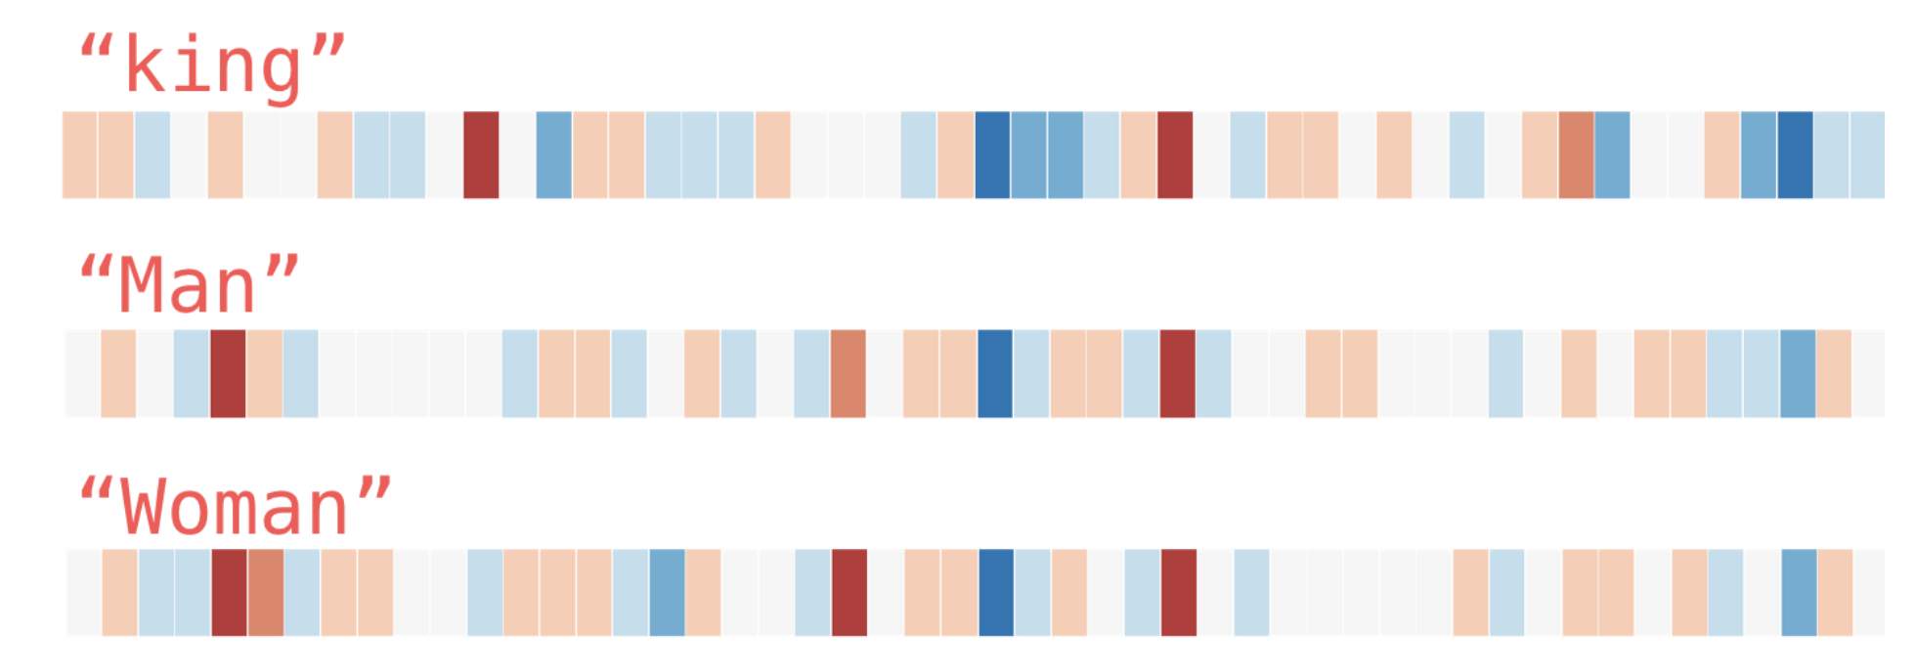
Word Embeddings
ML for Biomedical Research @ BSC
May 22nd, 2025
10

Slide 11
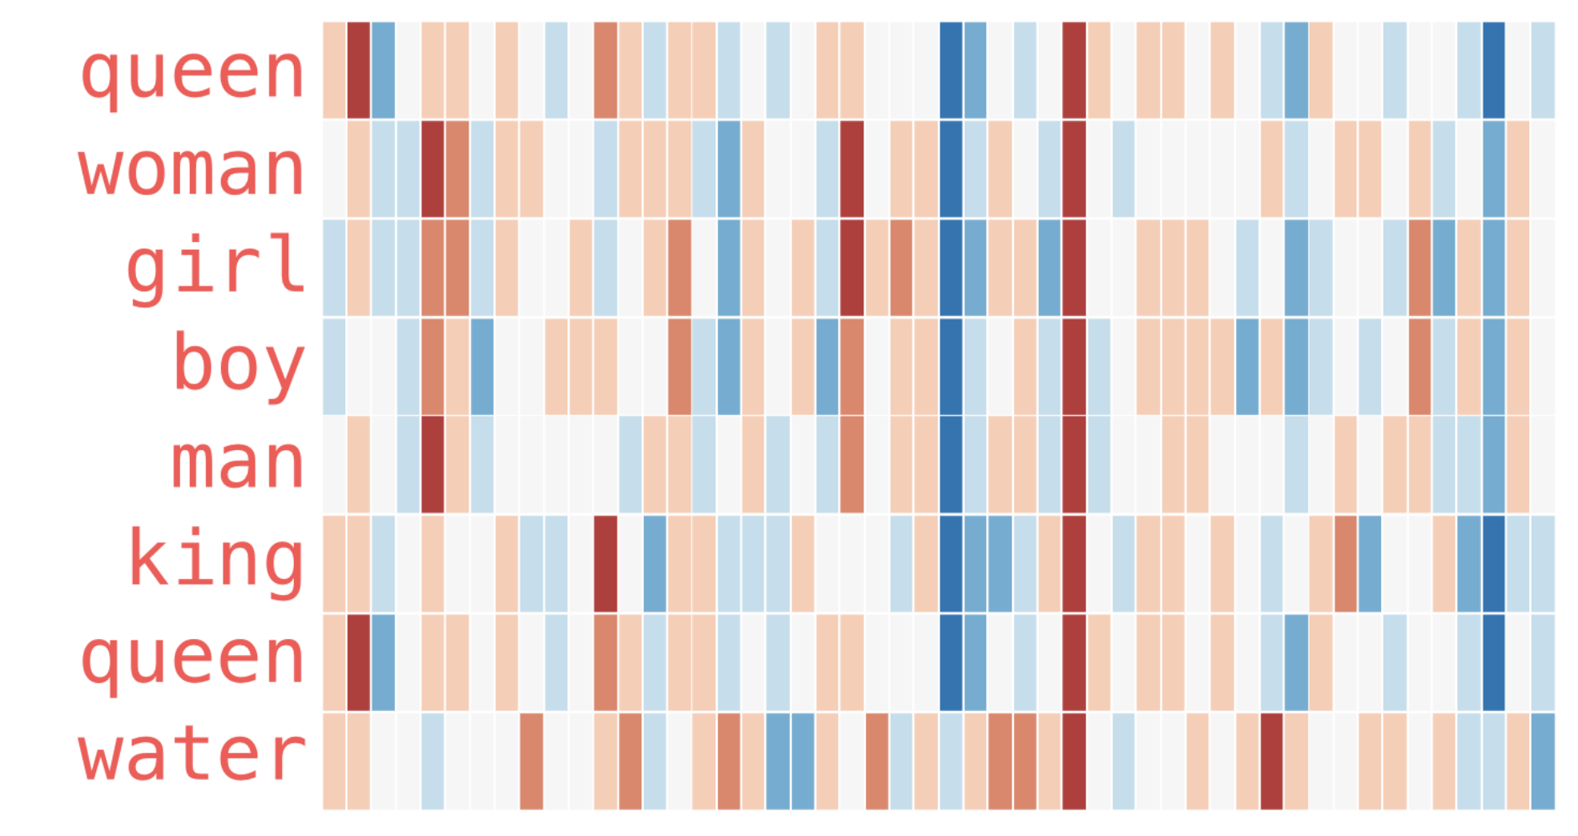
Word Embeddings
ML for Biomedical Research @ BSC
May 22nd, 2025
11

Slide 12
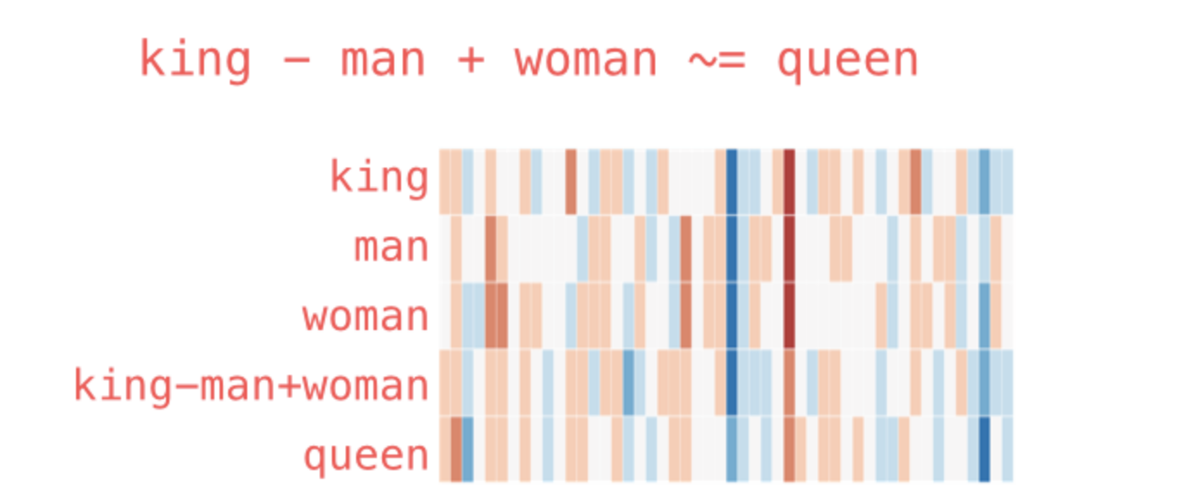
Word Embeddings
ML for Biomedical Research @ BSC
May 22nd, 2025
12

Slide 13
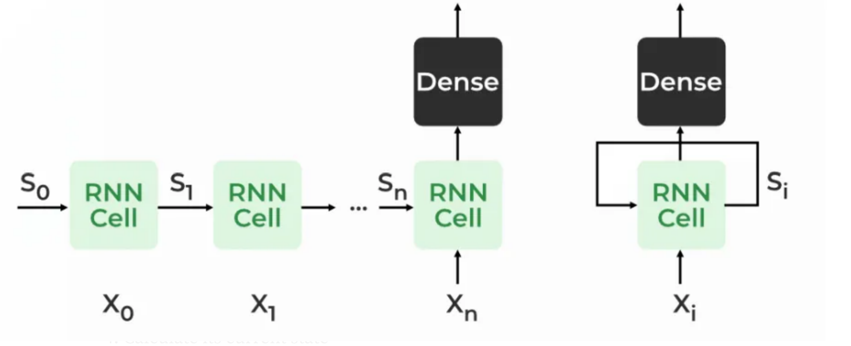
RNNs and LSTMs
ML for Biomedical Research @ BSC
May 22nd, 2025
13

Slide 14
The 2017 Breakthrough
Major Challenges:
Limited scalability
Order awareness
Long-range dependencies
Vanishing gradients
ML for Biomedical Research @ BSC
May 22nd, 2025
14

Slide 15
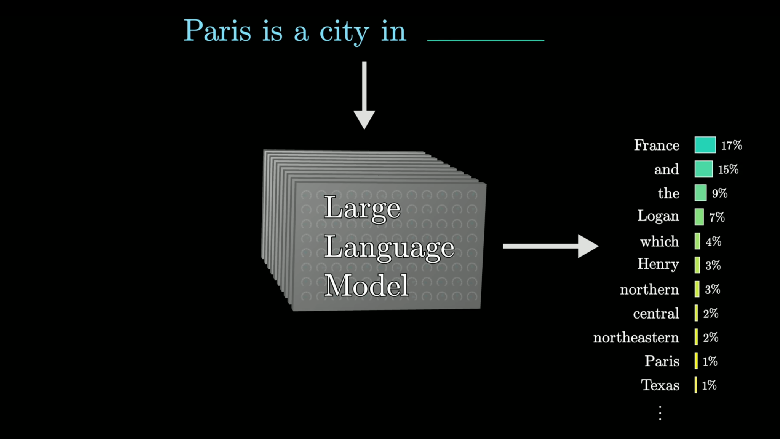
An Intro to LLMs
ML for Biomedical Research @ BSC
May 22nd, 2025
15

Slide 16
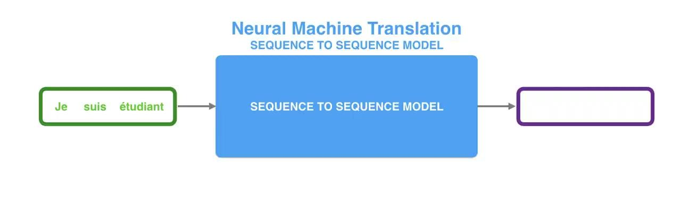
Attention is All You Need
ML for Biomedical Research @ BSC
May 22nd, 2025
16

Slide 17
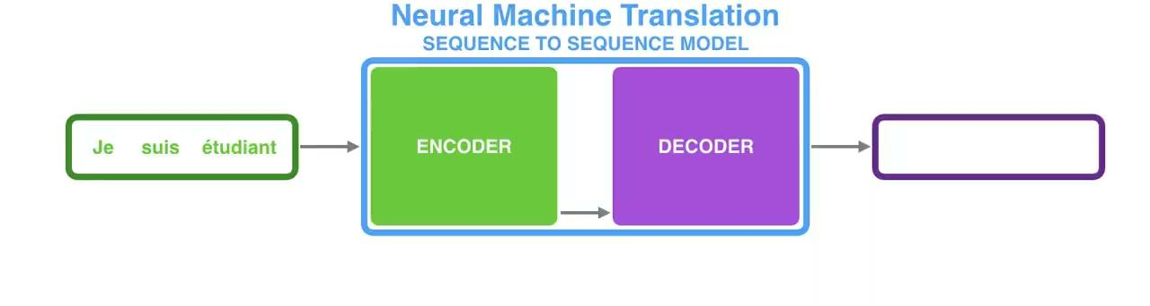
Attention is All You Need
ML for Biomedical Research @ BSC
May 22nd, 2025
17

Slide 18
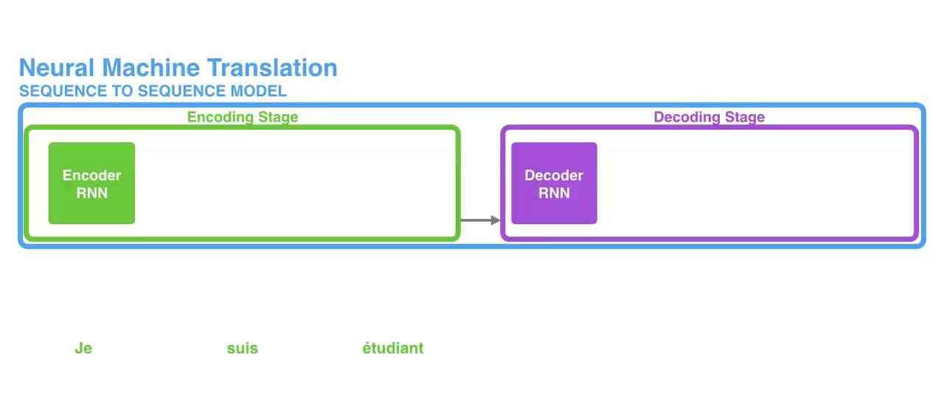
Attention is All You Need
ML for Biomedical Research @ BSC
May 22nd, 2025
18

Slide 19
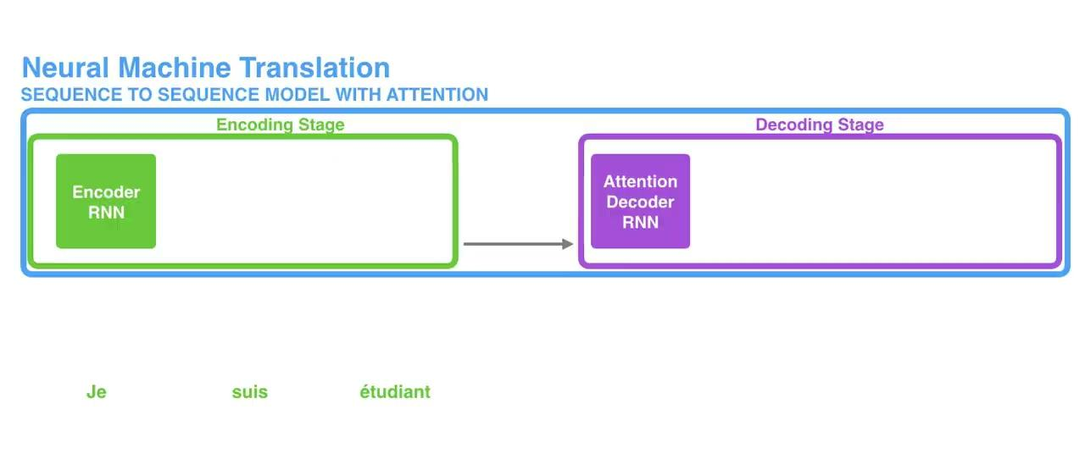
Attention is All You Need
ML for Biomedical Research @ BSC
May 22nd, 2025
19

Slide 20
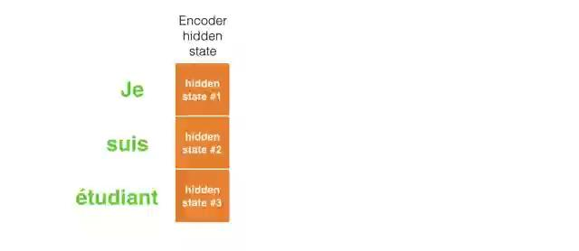
Attention is All You Need
ML for Biomedical Research @ BSC
May 22nd, 2025
20

Slide 21
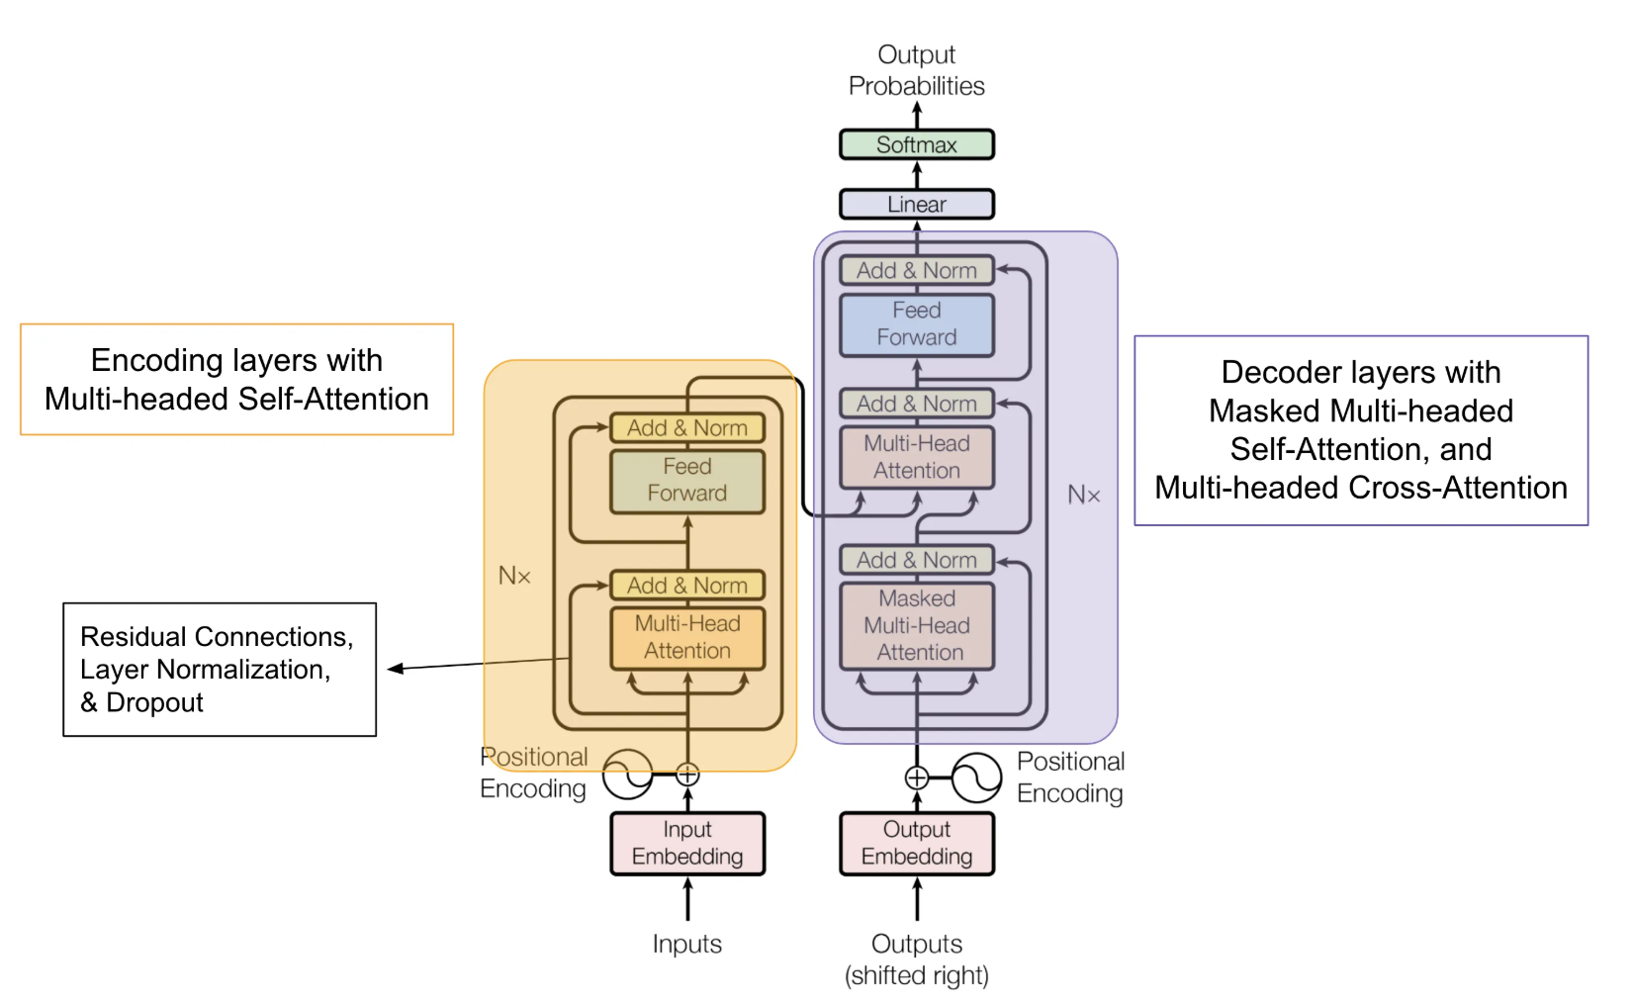
The Anatomy of a Transformer
ML for Biomedical Research @ BSC
May 22nd, 2025
21

Slide 22

HuggingFace & Open-source Models
ML for Biomedical Research @ BSC
May 22nd, 2025
13

Slide 23
NLP Problems: A Demo
Sentence Classification
Named Entity Recognition
Text Generation
Questions & Answers
ML for Biomedical Research @ BSC
May 22nd, 2025
14

Slide 24

Beyond Text: Vision Transformers
ML for Biomedical Research @ BSC
May 22nd, 2025
15

